Slide 2
Design and implementation
department INTEC
research group IDLab
Software Development & Operations

Slide 3
Overview
Implementation issues
Documentation
Open source development

Slide 4
Design and implementation
Software design and implementation is the stage in the software engineering process at which an executable software system is developed
Software design and implementation activities are invariably interleaved
Software design is a creative activity in which you identify software components and their relationships, based on a customer’s requirements
Implementation is the process of realizing the design as a program

Slide 5
Implementation issues

Slide 6
Implementation issues
Focus here is not on programming, but on issues that are often not covered in programming texts
Reuse
Most modern software is constructed by reusing existing components or systems
When developing software, you should make as much (legal!) use as possible of existing code
Configuration management
During the development process, you have to keep track of the many different versions of each software component in a configuration management system
Host-target development
Production software does not usually execute on the same computer as the software development environment
Develop it on one computer (the host system) and execute it on a separate computer (the target system)

Slide 7
REUSE
From the 1960s to the 1990s, most new software was developed from scratch, by writing all code in a high-level programming language
Only significant reuse of software was the reuse of functions and objects in libraries
Costs and schedule pressure mean that this approach became increasingly unviable, especially for commercial and Internet-based systems
An approach to development based around the reuse of existing software emerged and is now generally used

Slide 8
Reuse levels
The abstraction level
At this level, you don’t reuse software directly but use knowledge of successful abstractions in the design of your software
The object level
At this level, you directly reuse objects from a library rather than writing the code yourself
The component level
Components are collections of objects and object classes that you reuse in application systems
The system level
At this level, you reuse entire application systems

Slide 9
Reuse costs
The costs of the time spent in looking for software to reuse and assessing whether or not it meets your needs
Where applicable, the cost of buying the reusable software
For large off-the-shelf systems, these costs can be very high
The cost of adapting and configuring the reusable software components or systems
To reflect the requirements of the system that you are developing
The costs of integrating reusable software elements with each other (if you are using software from different sources) and with the new code that you have developed

Slide 10
Configuration management
Configuration management is the name given to the general process of managing a changing software system
Aim: to support the system integration process so that all developers can access the project code and documents in a controlled way, find out what changes have been made, and compile and link components to create a system

Slide 11
Configuration management activities
Version management
To keep track of the different versions of software components
Version management systems include facilities to coordinate development by several programmers
System integration
To help developers define what versions of components are used to create each version of a system
Used to build a system automatically by compiling and linking the required components
Problem tracking
Allow users to report bugs and other problems
Allow all developers to see who is working on these problems and when they are fixed

Slide 12
Configuration management tool interaction

Slide 13
Host-target development
Most software is developed on one computer (the host), but runs on a separate machine (the target)
More generally, we can talk about a development platform and an execution platform
Development platform usually has different installed software than execution platform

Slide 14
documentation

Slide 15
The importance of Code documentation
As most software development is done in teams, it is important to document APIs and code
Lots of (mature) tools can generate API documentation from comments in the source code
Examples in the next slides using JavaDoc

Slide 16
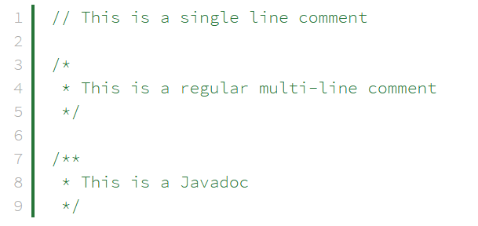
Javadoc comments
Structure similar to regular multi-line comments (extra asterisk at beginning)
JavaDoc comments can be placed above any class, method or field which needs documentation
Commonly two sections: general description and block tags (@ symbol) which describe specific meta-data

Slide 17
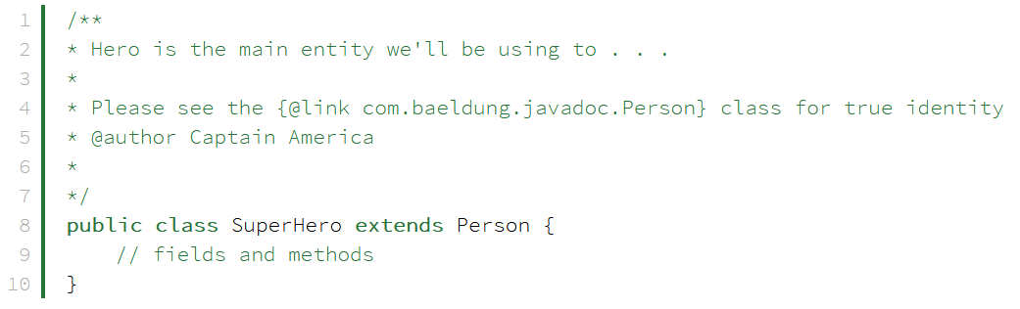
Javadoc at class level
Example: short description and two different block tags, standalone and inline
Standalone tags appear after the description with the tag as the first word in a line e.g. the @author tag
Provides name of the author who added the class, method or field that is commented
Inline tags may appear anywhere and are surrounded with curly brackets e.g. The @link tag
Provides inline link to a referenced part of the source code

Slide 18
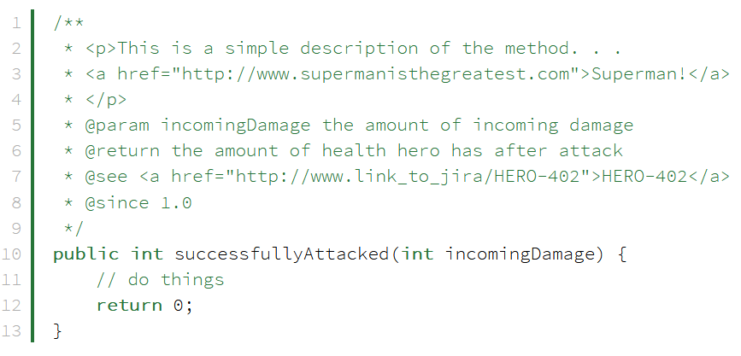
Javadoc at method level
Methods can contain a variety of Javadoc block tags
The sample successfullyAttacked method contains both a description and numerous standalone block tags
There are many block tags to help generate proper documentation and we can include all sorts of different kinds of information. We can even utilize basic HTML tags in the comments
Tags encountered in the example:
@param provides any useful description about a method's parameter or input it should expect
@return provides a description of what a method will or can return
@see will generate a link similar to the {@link} tag
@since specifies which version the class, field, or method was added to the project
@version specifies the version of the software
@throws is used to explain exceptions
@deprecated gives an explanation of why code was deprecated, when it may have been deprecated, and what the alternatives are

Slide 19
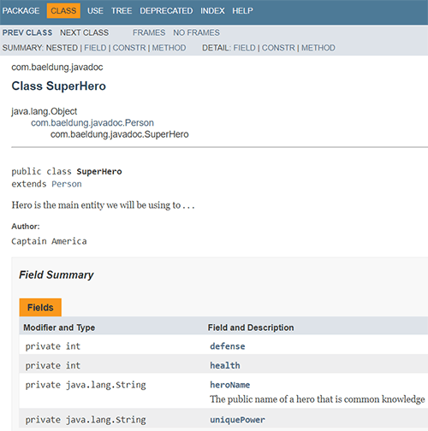
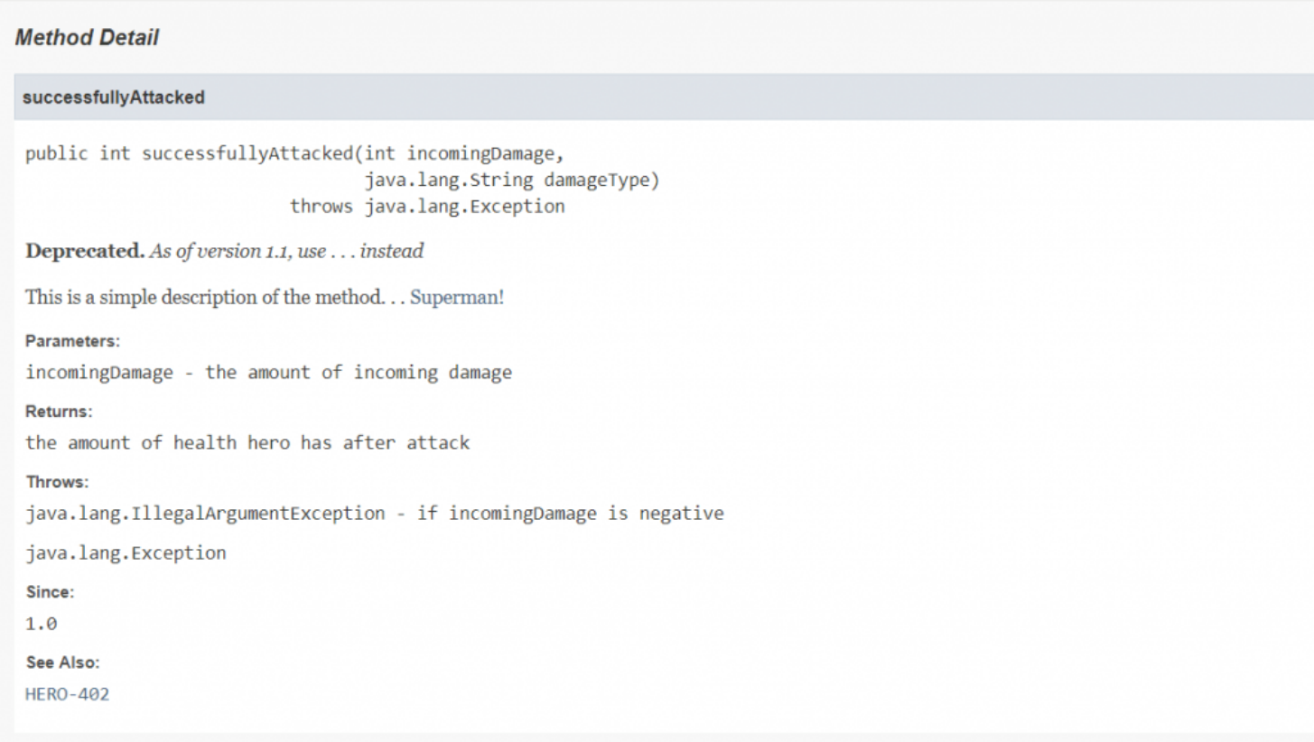
Javadoc tool output
Javadoc tool scans source files for Javadoc comments and generates HTML documentation for classes and methods

Slide 20


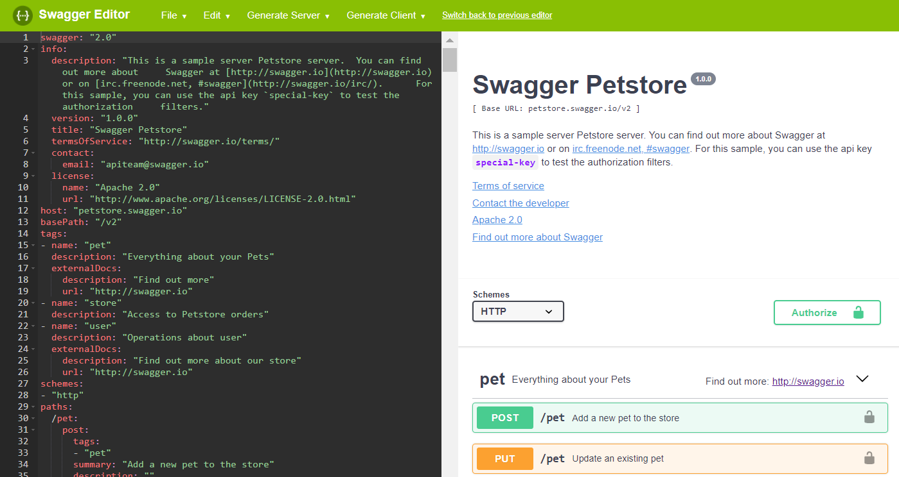
Interface definition language
Interface Definition Language describe a software component’s API in a language independent way
Specification languages for REST APIs
Original REST did not have an IDL
Most popular: OpenAPI
Swagger (https://swagger.io/) is a set of tools for REST API management
Allows describing entire API
Endpoints, operations on each endpoint, operation parameters, authentication methods, contact information, license, terms of use, etc.

Slide 21
Open source development

Slide 22
Open-source development
An approach to software development in which the source code of a software system is published and volunteers are invited to participate in the development process
Roots are in the Free Software Foundation (www.fsf.org), advocating that source code should not be proprietary but rather should always be available for users to examine and modify as they wish
Open-source software extended this idea by using the Internet to recruit a much larger population of volunteer developers
Questions
Should the product that is being developed make use of open-source components?
Should an open-source approach be used for the software’s development?

Slide 23
Open-source business
More and more product companies are using an open-source approach to development
Their business model is not reliant on selling a software product but on selling support for that product
They believe that involving the open-source community will allow software to be developed cheaper, more quickly and will create a community of users for the software

Slide 24
Open-source licensing
A fundamental principle of open-source development is that source code should be freely available, this does not mean that anyone can do as they wish with that code
Legally, the developer of the code (either a company or an individual) still owns the code: they can place restrictions on how it is used by including legally binding conditions in an open-source software license
Some open-source developers believe that if an open-source component is used to develop a new system, then that system should also be open-source
Others are willing to allow their code to be used without this restriction
The developed systems may be proprietary and sold as closed-source systems

Slide 25
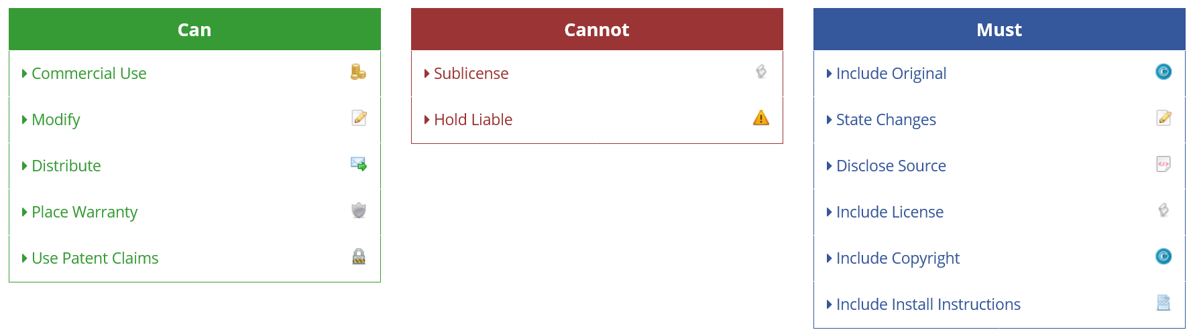
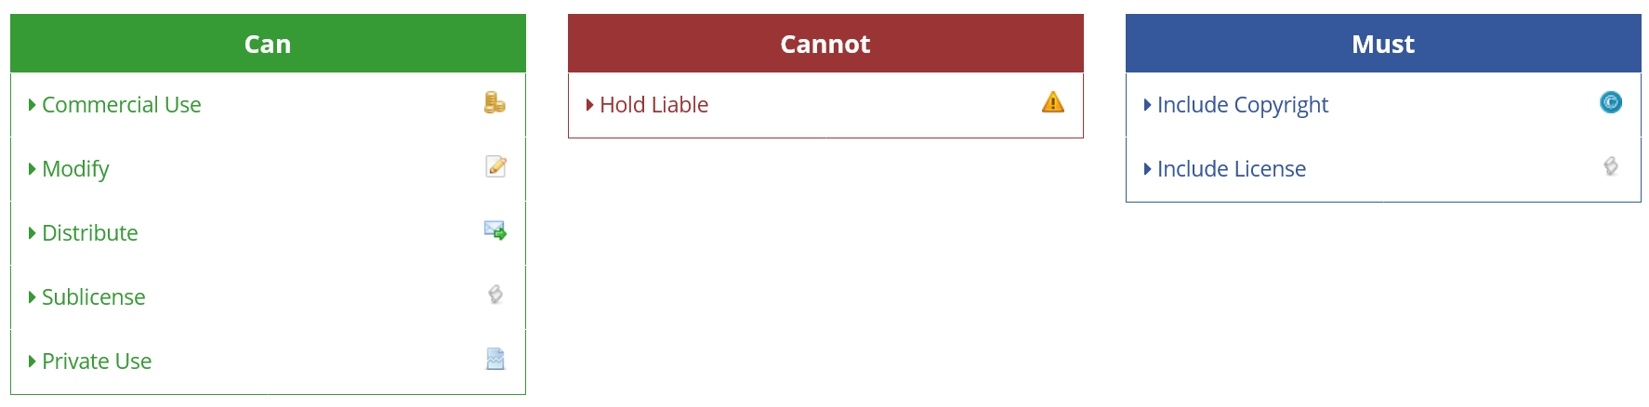
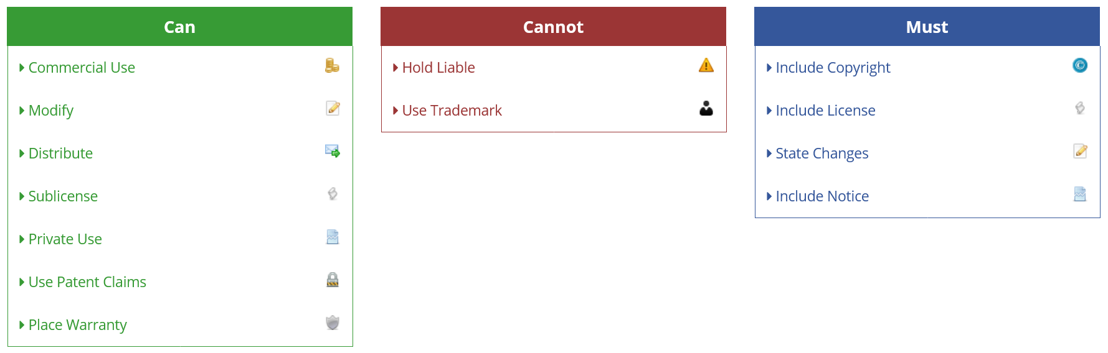
License models
The GNU General Public License (GPL)
A so-called ‘reciprocal’ license that means that if you use open- source software that is licensed under the GPL license, then you must make that software open-source
MIT
A short, permissive software license: you can do whatever you want as long as you include the original copyright and license notice in any copy of the software/source
Many variations of this license in use
Apache 2.0
You can do what you like with the software, as long as you include the required notices. This permissive license contains a patent license from the contributors of the code.

Slide 26
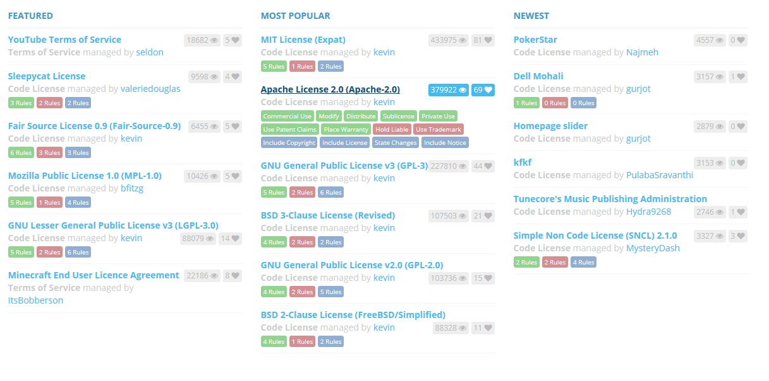
https://tldrlegal.com/

Slide 27
License management
Establish a system for maintaining information about open-source components that are downloaded and used
Be aware of the different types of licenses and understand how a component is licensed before it is used
Be aware of evolution pathways for components
Have auditing systems in place that detect e.g. if you break the terms of a license
Educate people about open-source
(Participate in the open-source community)

Slide 28
Key points

Slide 29
Key points
When developing software, you should always consider the possibility of reusing existing software, either as components, services or complete systems
Configuration management is the process of managing changes to an evolving software system
Essential when a team of people are cooperating to develop software
Most software development is host-target development
Use an IDE on a host machine to develop the software, which is transferred to a target machine for execution
Documentation is important when implementing software
Tools exist for both code documentation and API documentation
Open-source development involves making the source code of a system publicly available
Many people can propose changes and improvements to the software
Important to know licenses

